Slide 1
Data Communications
Data Communications
Data Communication is the exchange of data (in the form of 0’s and 1’s) between two devices via some form of transmission medium (such a cable)
What is important?
  Delivery (deliver data to the correct destination)
  Accuracy (must deliver the data accurately, no altered data in transmission)
  Timeliness (deliver data in timely manner, data delivered late are useless)

Slide 2
Aspects of Data Communications
Components
Data representation
Direction of data flow

Slide 3
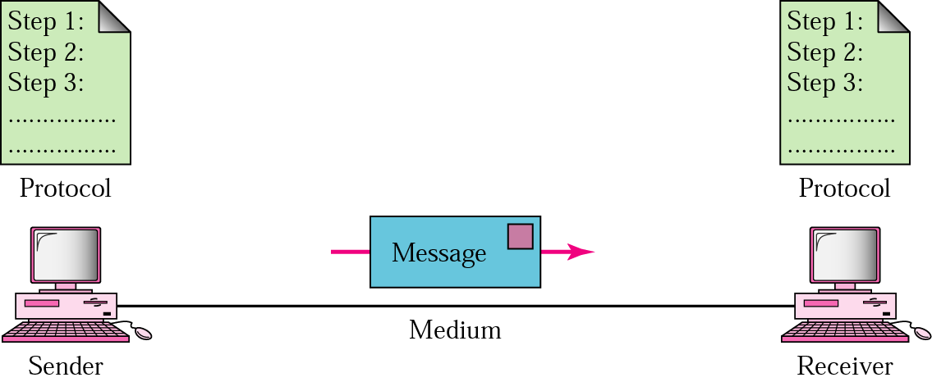
Components

Slide 4
Components (contd.)
Components of a Communication System
Message: The message is the information (or data) to be transmitted. For example, text, numbers, pictures, sound, video, or any combination of these.
Sender: The sender is the device that sends the data message . It can be a computer, telephone, video camera, and so on.
Receiver: The receiver is the device that receives the message.
Medium (Channel): The transmission medium is the physical path by which a message travels from the sender to receiver. For example twisted pair wire, coaxial cable, fiber-optic cable, radio waves (terrestrial or satellite microwaves).

Slide 5
Components (contd.)
Protocol: A protocol is a set of rules that govern data communication. It represents an agreement between the communicating devices.

Slide 6
Data Representation
Text
  Represented as a bit pattern
  Various codes: ASCII (7 bits), Extended ASCII (8 bits), Unicode (16 bits), ISO (32 bits)
Numbers
  Directly converted to a binary number
Images
  jpeg, gif, etc.
Audio
  mp3, wma,
Video
  mp4, avi, etc.

Slide 7
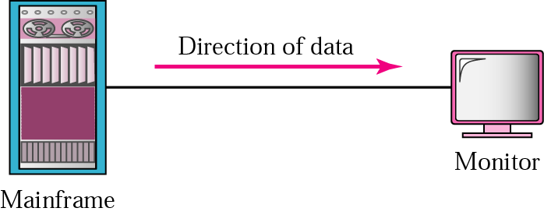
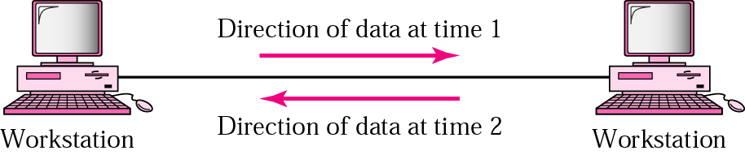
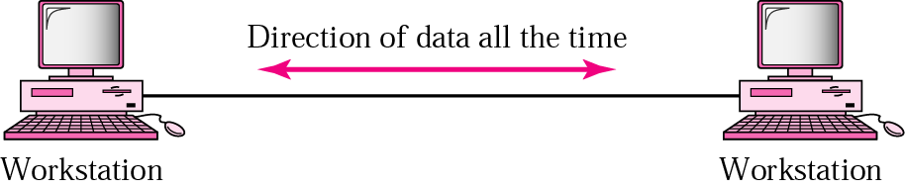
Direction of Data Flow
Simplex
Half-duplex
Full-duplex

Slide 8
Networking
Network
A network is a set of devices (often referred to as nodes) connected by links. A node can be a computer, printer, or any other device capable of sending and/or receiving data generated by other nodes on the network.
Network criteria
  Performance
  reliability
  security

Slide 9
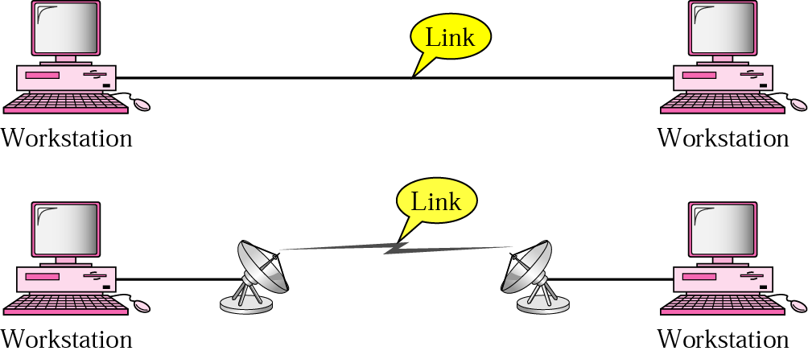
Point-to-Point Connection
A point-to-point line configuration provides a dedicated link between two devices. The entire capacity of the channel is reserved for transmission between those two devices.

Slide 10
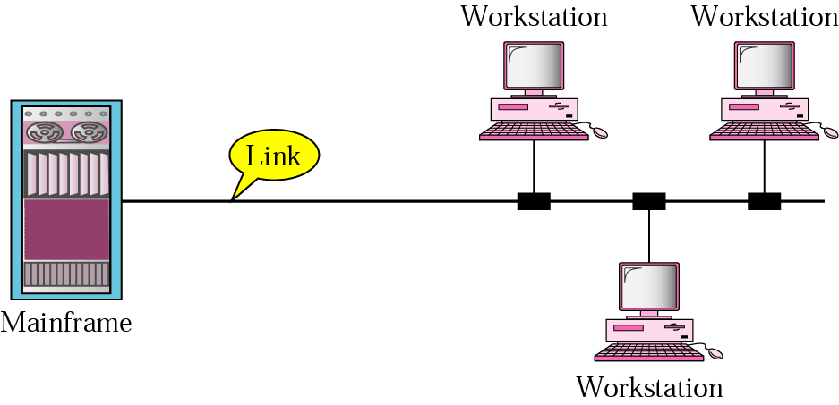
Multi-point Connection
A multipoint line configuration is one in which more than two specific devices share a single link. In a multipoint environment, the capacity of the channel is shared, either spatially or temporally.

Slide 11
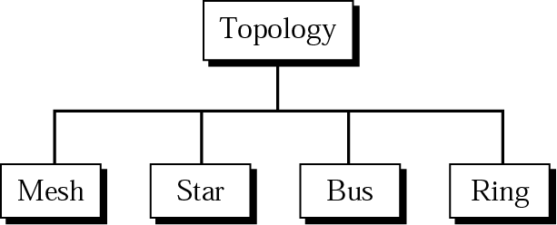
Physical Topologies
The topology of a network is the geometric representation of the relationship of all links and linking devices to one other. Two or more devices connect to a link; two or more links form a topology.

Slide 12
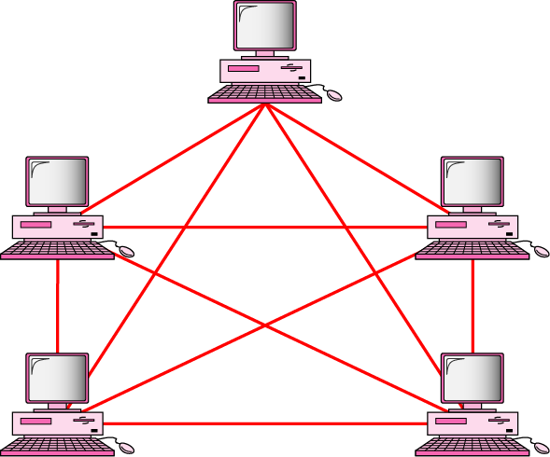
Mesh Topology
In a mesh topology, every device has a dedicated point-to-point link to every other device. The term dedicated means that the link carries traffic only between the two devices it connects.

Slide 13
Mesh Topology (contd.)
Advantages
The use of a dedicated links guarantees that each connection can carry its own load, thus eliminating the traffic problems that can occur when links must be shared by multiple devices.
A mesh topology is robust. If one link becomes unusable, it does not incapacitate the entire system.
Privacy. When every message sent travels along a dedicated link, only the intended recipient sees it. Physical boundaries prevent other users from gaining access to messages.
Point-to Point links make fault identification and fault isolation easy.

Slide 14
Mesh Topology (contd.)
Disadvantages
A big amount of cabling and a big number of I/O ports required, i.e, the hardware required can be very expensive.
Because every device must be connected to every other device, installation and reconfiguration are difficult.
For these reasons a mesh topology is usually implemented in a limited fashion.
For example, as a backbone connecting the main computers to a hybrid network that can include several other topologies.

Slide 15
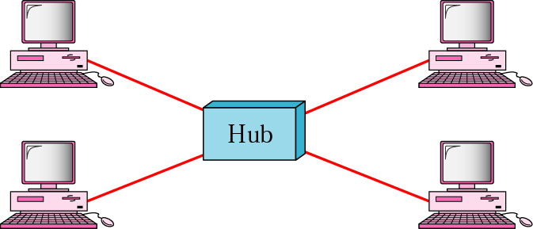
Star Topology
In a star topology, each device has a dedicated point-to-point link only to a central controller, usually called a hub. A star topology does not allow direct traffic between devices. If one device wants to send data to another, it sends the data to the controller, which then relays the data to the other connected device.

Slide 16
Star Topology (contd.)
Advantages
It is easy to install and reconfigure
The star topology is robust. If one link fails, only that link is affected. This factor also lends itself to easy fault identification and fault isolation.
Disadvantages
A big amount of cabling and a big number of I/O ports required, i.e, the hardware required can be very expensive.
Note: Star topology requires far less cable than Mesh topology.

Slide 17
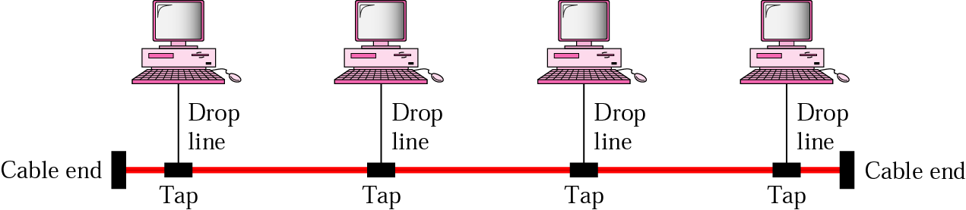
Bus Topology
In a bus topology one long cable acts as a backbone to link all the devices in the network. Nodes are connected to the bus cable by drop lines and taps. A drop line is a connection running between the device and the main cable. A tap is a connector that either splices into the main cable or punctures the sheathing of a cable to create a contact with the metallic core.

Slide 18
Bus Topology (contd.)
Advantages
Easy to install
Bus topology uses less cabling than mesh, star, or tree topologies.
Disadvantages
Difficult reconfiguration and fault isolation. A bus is usually designed to be optimally efficient at installation. It can therefore be difficult to add a new devices.
A fault or break in the bus cable stops all transmission, even between devices on the same side of the problem. The damaged area reflects signals back in the direction of origin, creating noise in both directions.

Slide 19
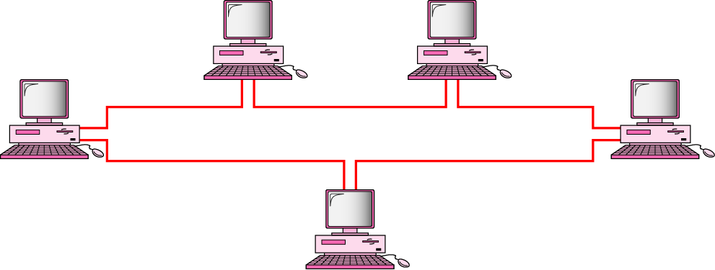
Ring Topology
In a ring topology, each device has a dedicated point-to-point line configuration only with the two devices on either side of it.

Slide 20
Ring Topology (contd.)
Advantages
Easy to install and reconfigure. To add or delete a device require only two connections.
Easy fault isolation
Disadvantages
A break in the ring (such as a disabled station) can disable the entire network.

Slide 21
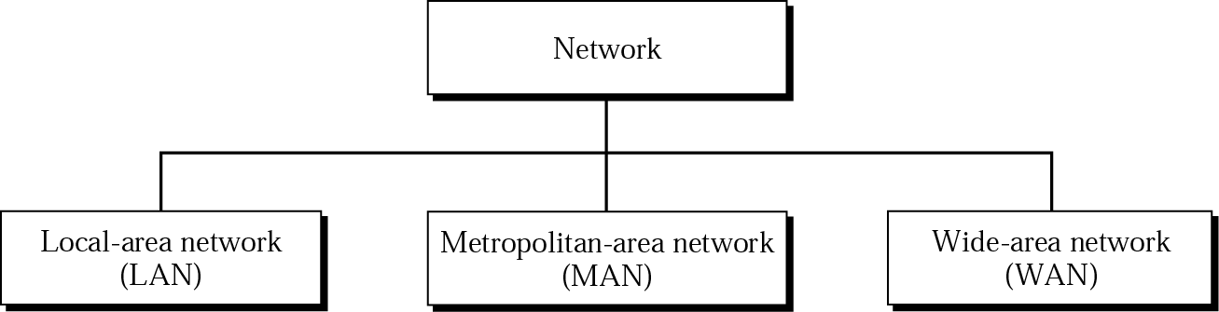
Categories of Networks

Slide 22
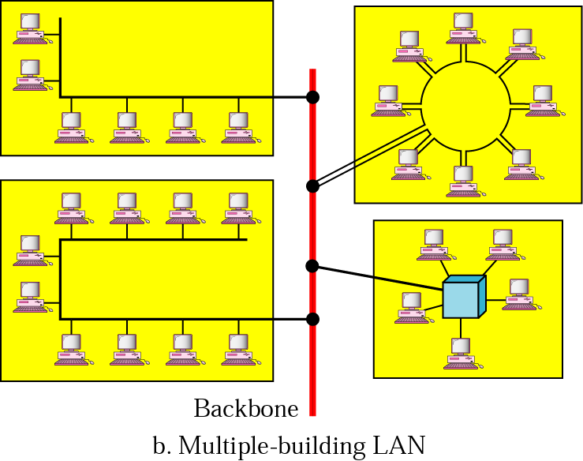
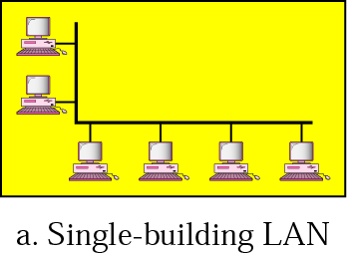
Local Area Networks
Typically, one type of transmission medium

Slide 23
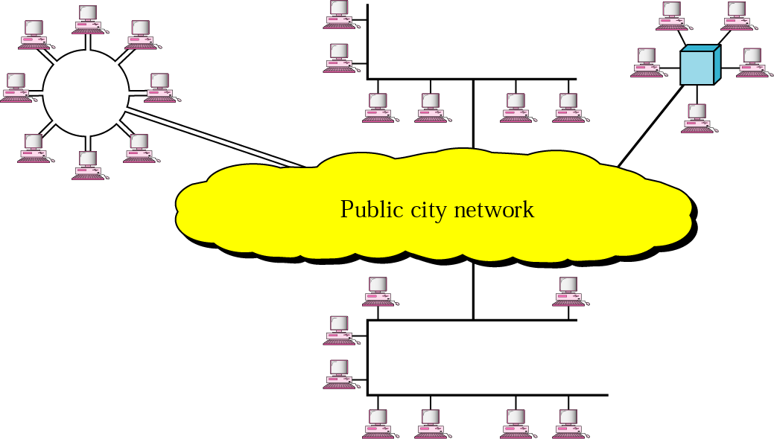
Metropolitan Area Networks

Slide 24
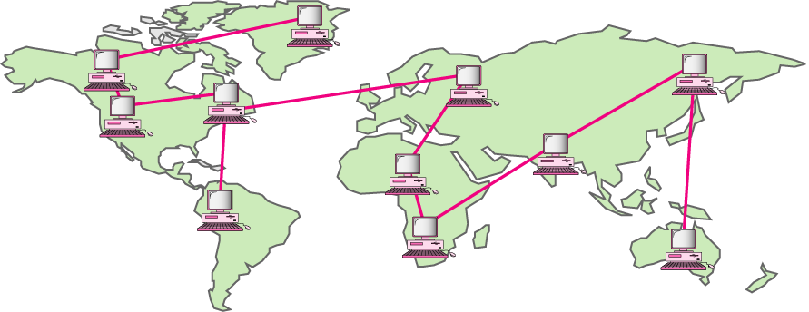
Wide Area Networks

